Slide 1
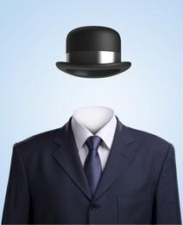
INVISIBLE TECHNOLOGY
Submitted by:
PRASHANT UPADHYAY
IT
ROLL NO-1812213801

Slide 2
OVERVIEW
What is invisibility?
It is possible in reality?
How does it work in science fiction?
Interaction of light with objects.
Can we bend light.
Metamaterials.
Transformation optics.
SSRs(Split Ring Resonator).
Application
Limitations.
Conclusion.

Slide 3
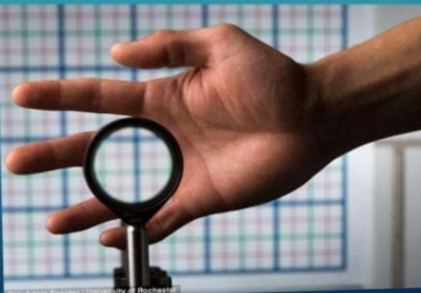
INVISIBILITY
The inability to be seen is called invisibility.
Invisibility is the state of an object that can not be seen an object in the state is to be invisible.

Slide 4
POSSIBLE?
Yes, it is possible?
Scientists in Germany have announced that they have been able to create a cloaking device that can render a 3D object invisible recently.
Earlier in Tokyo Prof. Tachi proposed to build something to make objects invisible back in 1977. He came up with a retro reflective material which causes the coat to act as screen and give an invisible effect.
Also in Duke University micro wave been deflection is being to used to created such an effect.

Slide 5
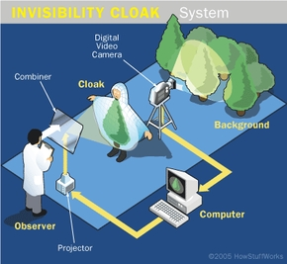
INVISIBILITY IN SCIENCE FICTION MOVIES

Slide 6
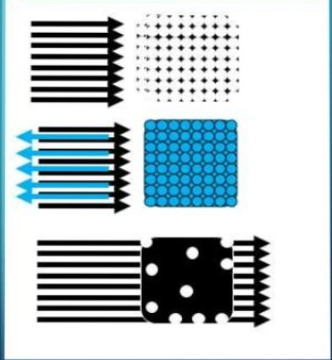
INTERACTION OF LIGHT WITH OBJECTS
ABSORPTION
REFLECTION
TRANSMISSION

Slide 7
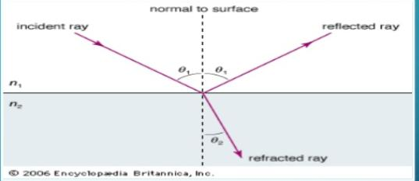
CAN WE BEND LIGHT?
yes - Refraction!!!
Refraction Law:n1sinθ= n2 sinθ2
N1>N2,then θ1<θ2;if n1<n2,then θ1>θ2; But that will change the direction of ray.

Slide 8
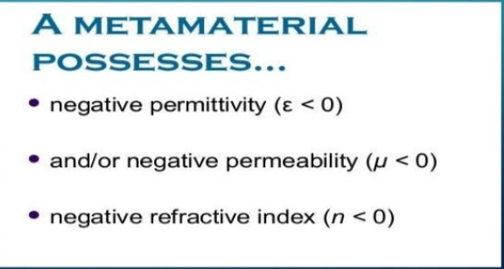
METAMATERIAL
Meta is a Greek Word meaning “beyond”.
Metamaterials (MMTs) are artificially engineered composit materials having extraordinary electromagnetics properties.

Slide 9
TRANSFORMATION OPTICS
Transformation optics offers great versatility for controlling electromagnetic waves to create materials with specially designed properties.
Transformation optics prescribes the metamaterials.
Maxwell’s equation are of the same from in any coordinate system but the precise values of permittivity and permeability will change.
The idea is quite straightforward: start with a field pattern that obeys Maxwell’s equations for a system that is topologically similar to the desired configuration but confined either to free space or a simple configuration of permittivity and permeability , then distort the system until the fields are in the desired configuration.

Slide 10
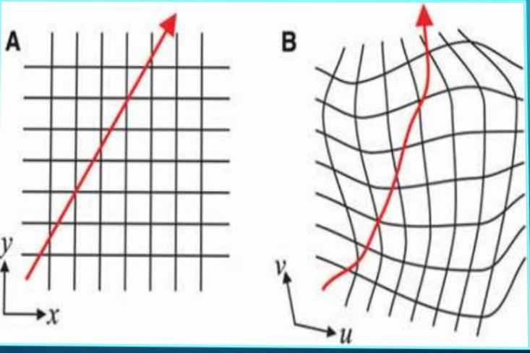

Slide 11
SSRS(SPLIT RING RESONATORS
SSRs are pair of concentric annular rings with split in them at opposite ends.
Made of non-magnetic metal like copper and have small gapes between them.
These tiny ring like structures are assembled giant crystalline structure.

Slide 12
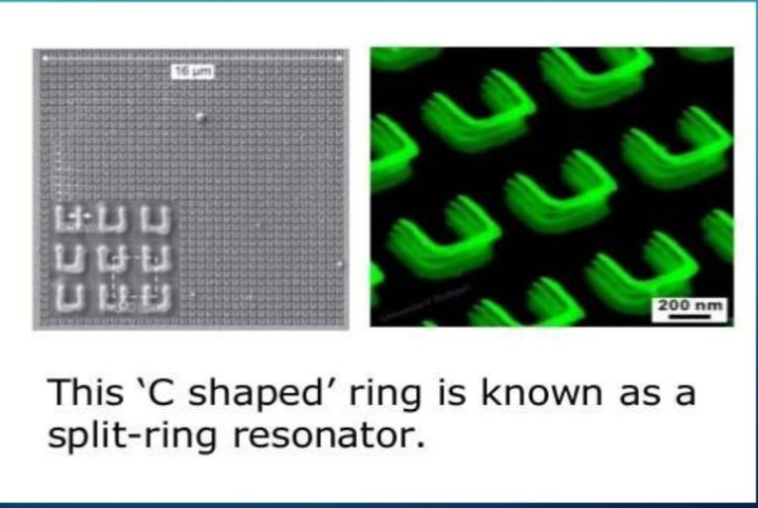

Slide 13
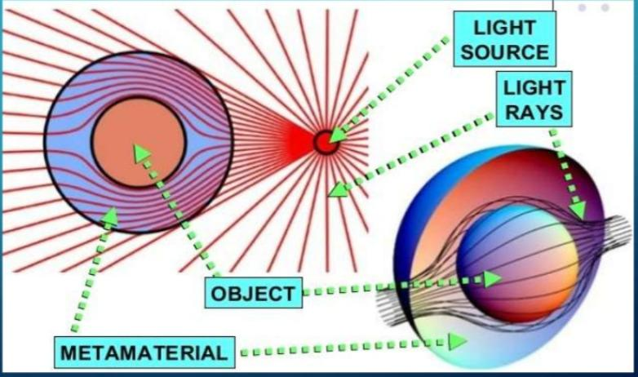
USE OF METAMATERIAL AS INVISIBILITY CLOAK

Slide 14
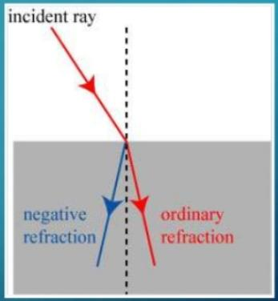
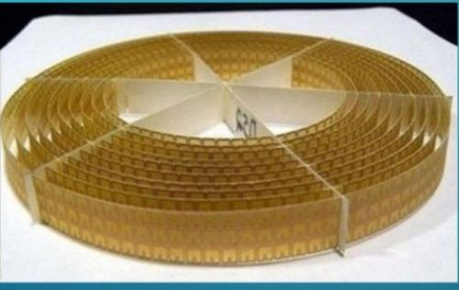
THE INVISIBILITY CLOAK
Metamaterials contain tiny implants which can control tha refractive index at every point in a material.
This would enable light to bend in a path around an object.

Slide 15
Applications
Cloaking Military Devices
Diagnosing Disease
Computing faster
Harvesting Energy
Magic ,art, fashion show

Slide 16
LIMITATIONS
The Invisibility Effect works only for a specific range of wavelengths. It operated only over a narrow range of frequency.
The cloak could be used to cover the volume of any shape,but moving the material would spoil the effect.
It is not very easy to get negative refractive index.

Slide 17
CONCLUSION
Is invisibility possible? ------→ YES
Is invisibility simple to accomplish?----→NO
However, we have already realised the 2D invisibility,we created the special material----→METAMATERIAL which has a lot of applications.
Further research in the field is going on.

Slide 18


